Slide 1



Challenges of Agricultural land Remediation and Renewal of Agriculture in Iitate Village by a collaboration between scholar and NPO
[H-CG31] [EJ] 福島第一原子力発電事故からの地域復興に貢献できること
2017.5.23
JpGU-AGU Joint meeting 2017
@Makuhari Messe, Chiba, Japan
Masaru MIZOGUCHI^{1,2}
Yoichi TAO² and Muneo KANNO²
1 Faculty of Agriculture, The University of Tokyo, Japan
2 NPO:Resurrection of Fukushima

Slide 2
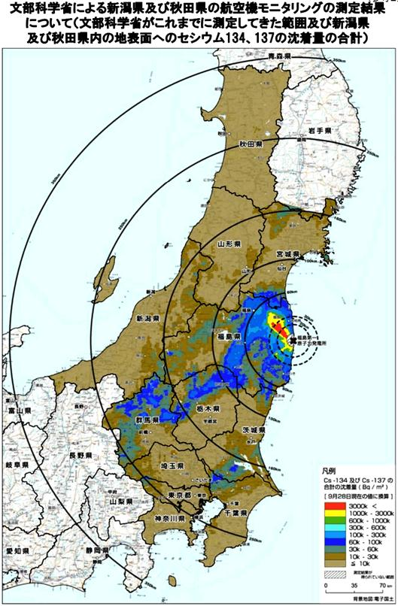
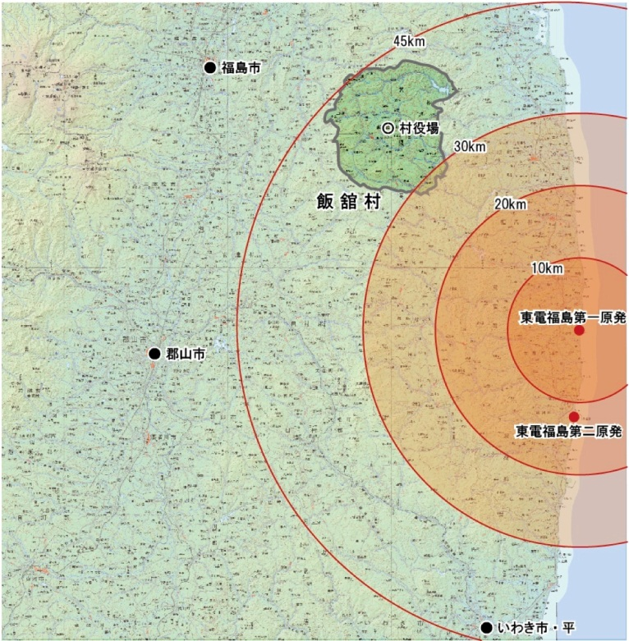
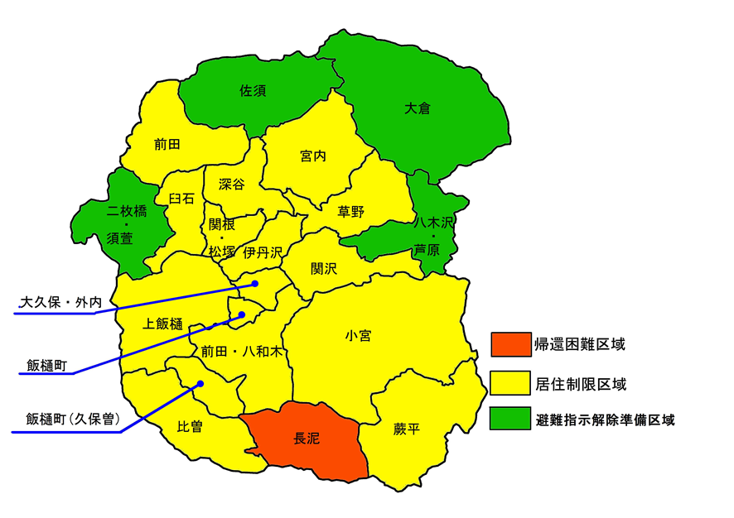
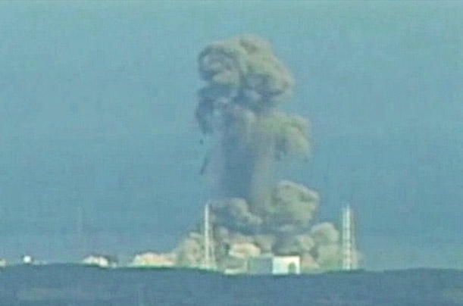
Iitate Village in Fukushima Prefecture
http://blog.goo.ne.jp/yampr7/e/3252e0611ebc1eabd36195cede8a2231

Slide 3
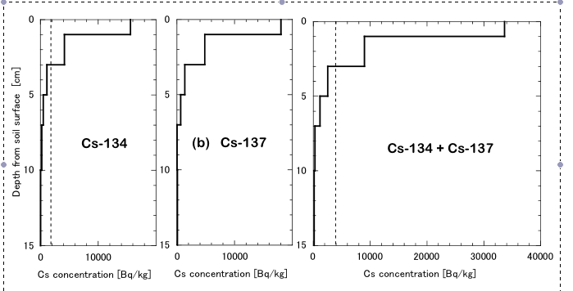
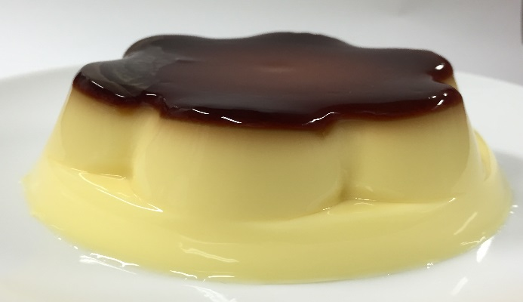
Vertical distribution of Cs in soil (24/5/2011)
Shiozawa et al. (2011): Vertical concentration profiles of radioactive cesium
and convective velocity in soil in a paddy field in Fukushima. Radioisotopes 60 : 323-328

Slide 4


Official decontamination methods by Government
From August, 2012
Stripping topsoil method
Soil puddling method
Deep plowing method

Slide 5
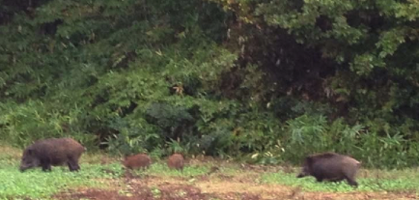
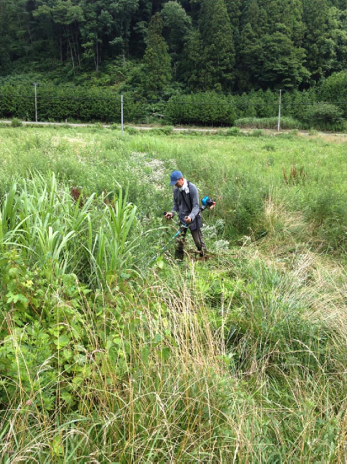
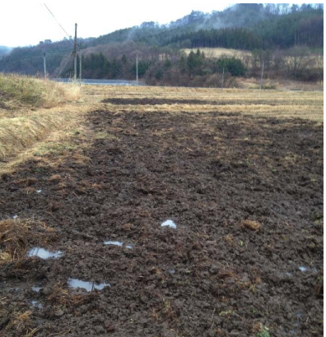
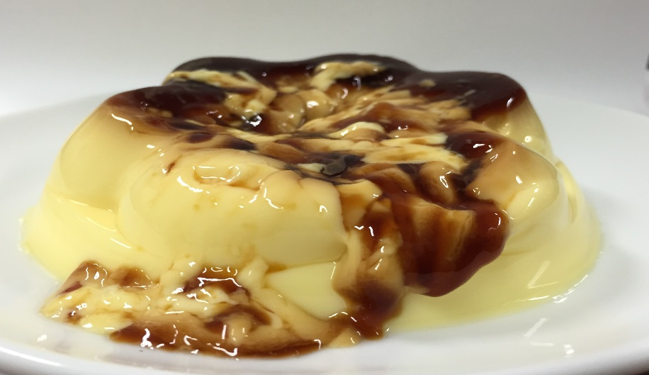
Reality of narrow agricultural field
Wild boars
Heavy Weed
Disturbed agricultural field
http://www.iai.ga.a.u-tokyo.ac.jp/mizo/edrp/fukushima/fsoil/PAWEES131030.pdf

Slide 6
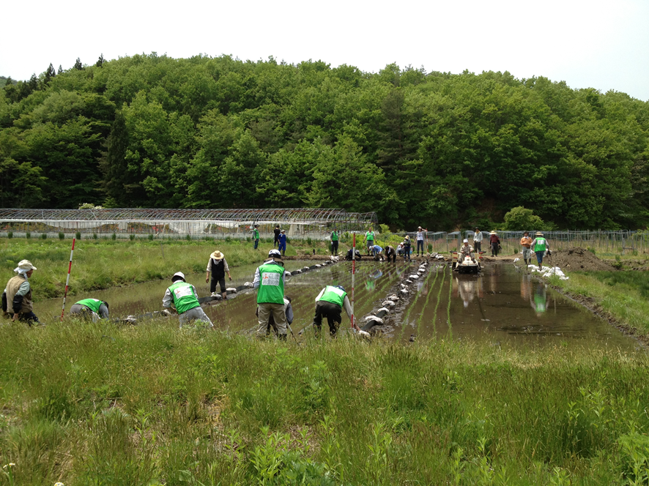

Development of decontamination method farmers can do by themselves in paddy contaminated by radiocaesium in Fukushima
Prof. Masaru Mizoguchi
Dept. of Global Agricultural Science
Univ. of Tokyo

Slide 7
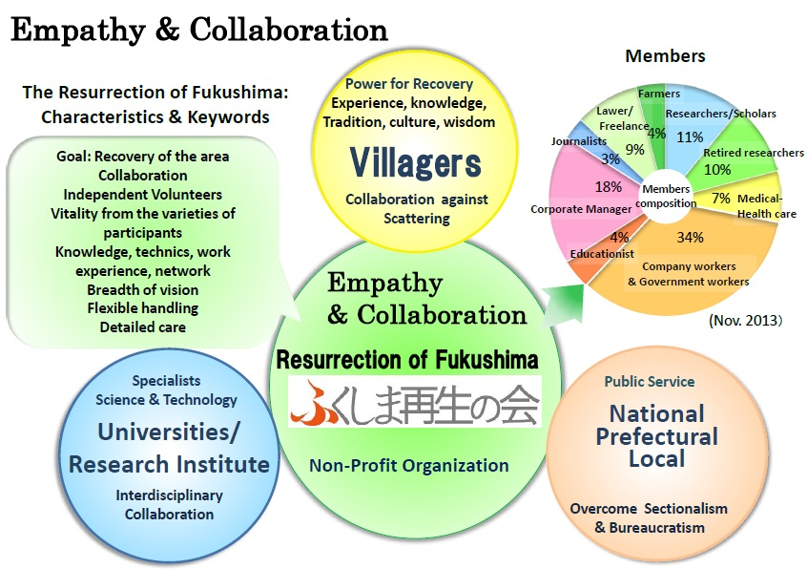
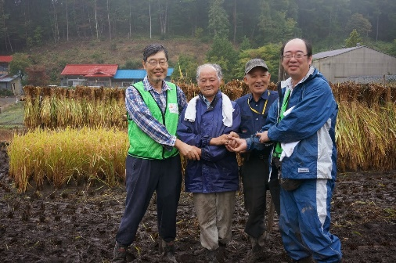

Slide 8
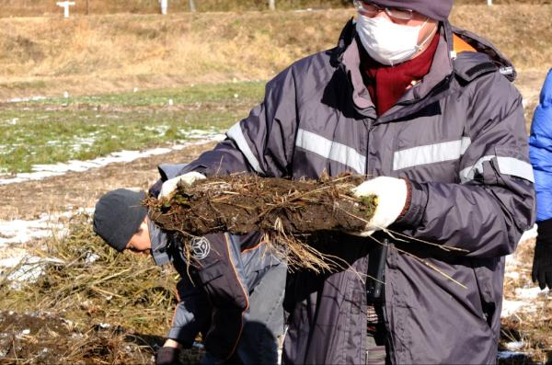
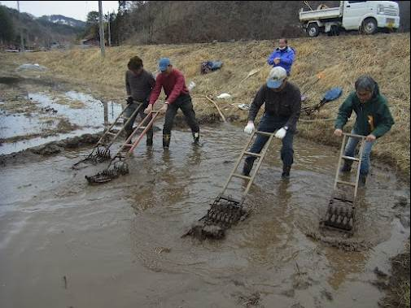
Practices utilizing the properties of cesium and clay (2012)
decontamination method by stripping frozen soil
（2012.1.8）
Rotary weeder method
(2012.４.1)

Slide 9
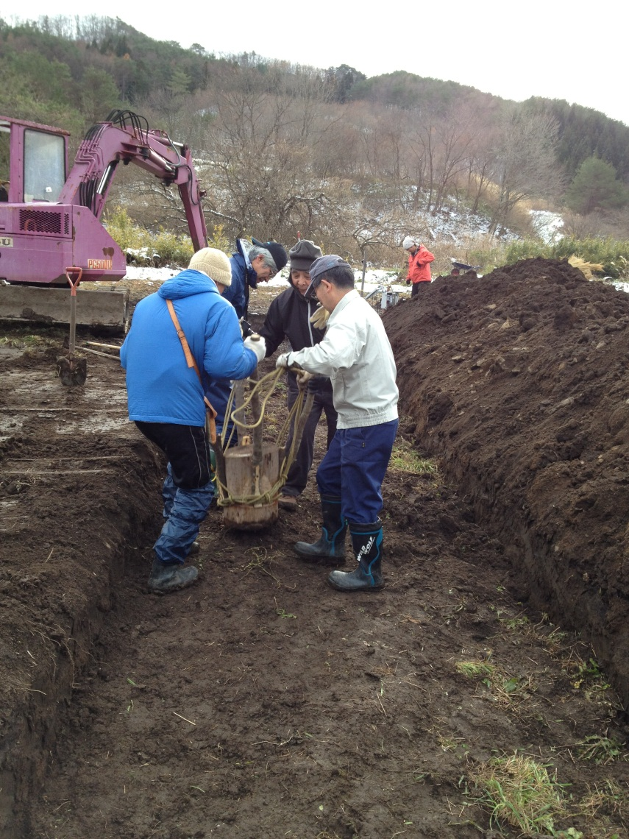
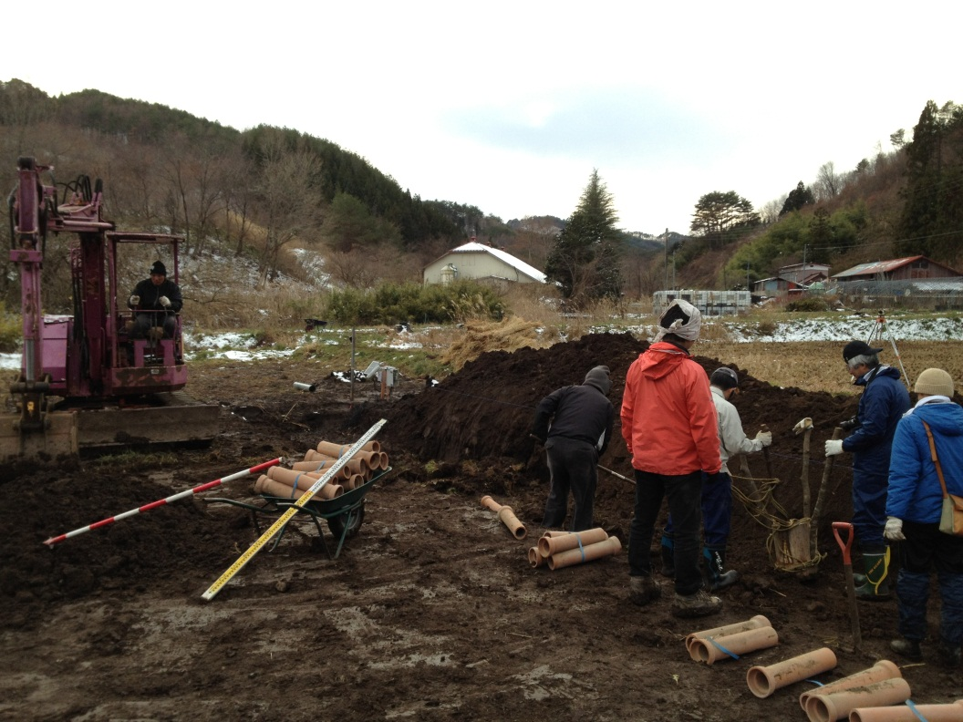
Made-method-1 (Sasu method)
Stripping topsoil + Deep plowing method
Burial of contaminated soil
Compaction of soil
2012.12.1

Slide 10
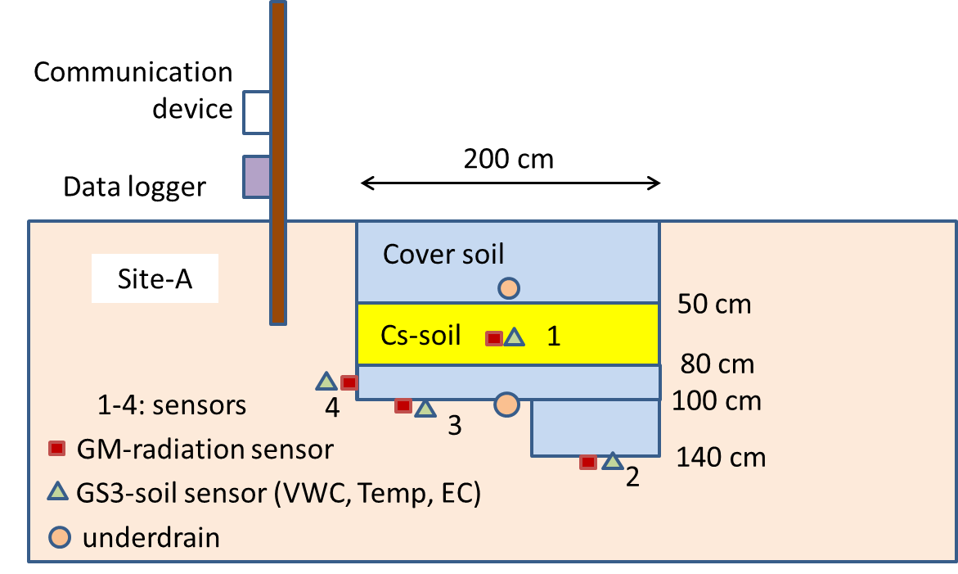
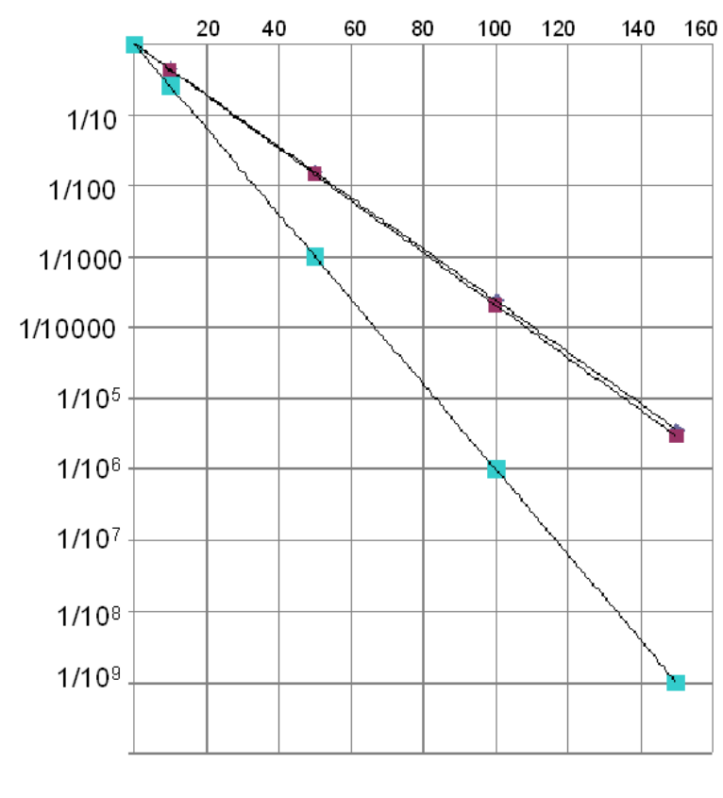
Contaminated soil should be buried in the bare hole!
Radiation dose is 1/100 to 1/1000 just bury 50cm deep!
Depth (cm)

Slide 11
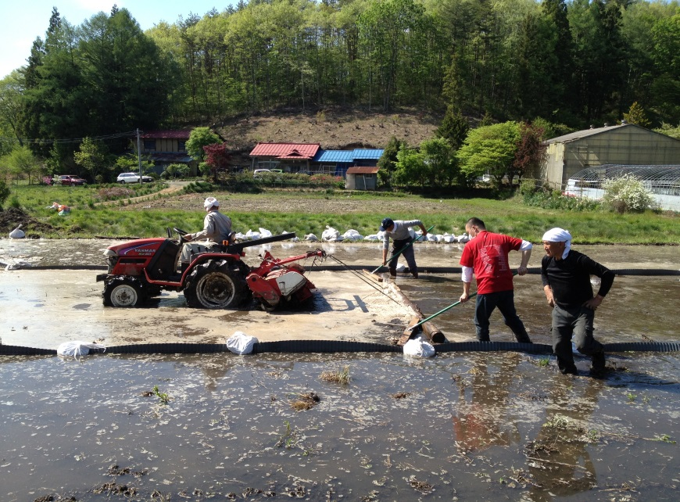
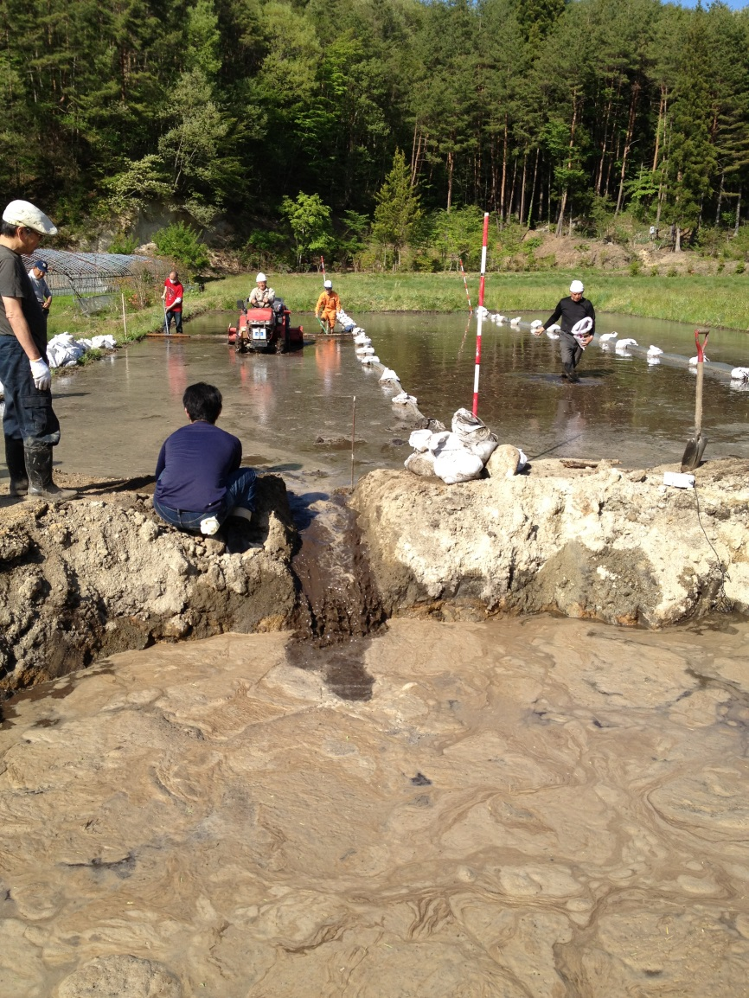
Made-method-2 (Komiya method)
Soil puddling + Deep plowing method (2013)
（2013.5.18）

Slide 12
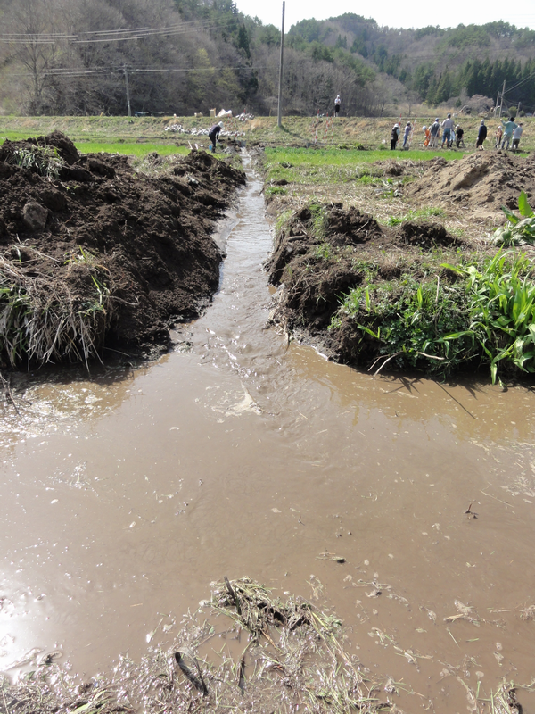
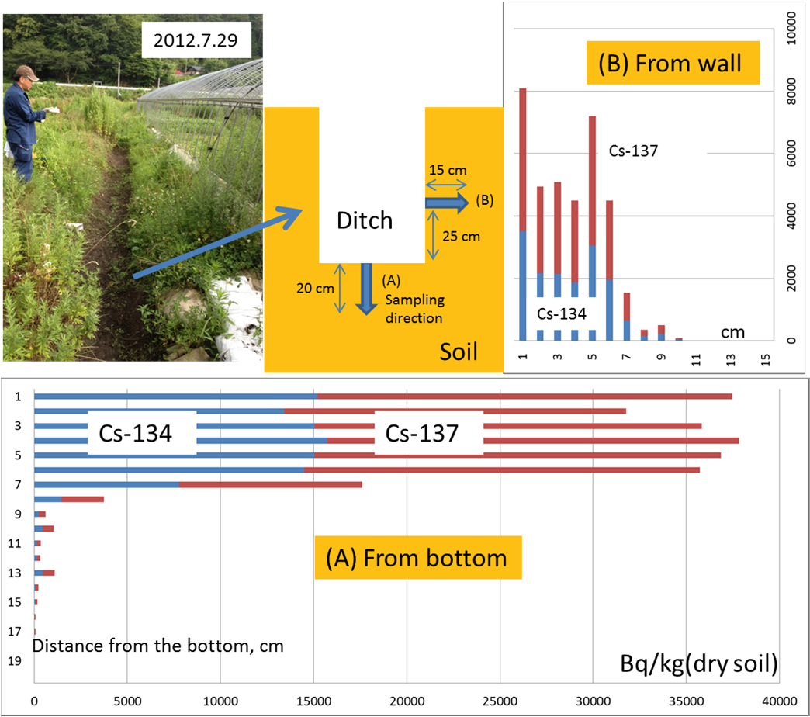
Pour contaminated muddy water into the drain
A result of the radioactivity measured at each depth by sampling the soil of the bottom and sides of the groove after a dried-up
Cesium is not expected to immersion in the soil!

Slide 13
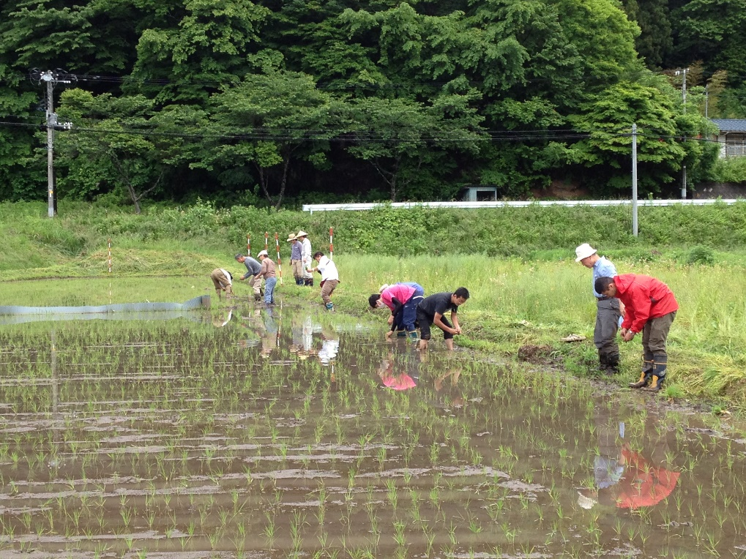
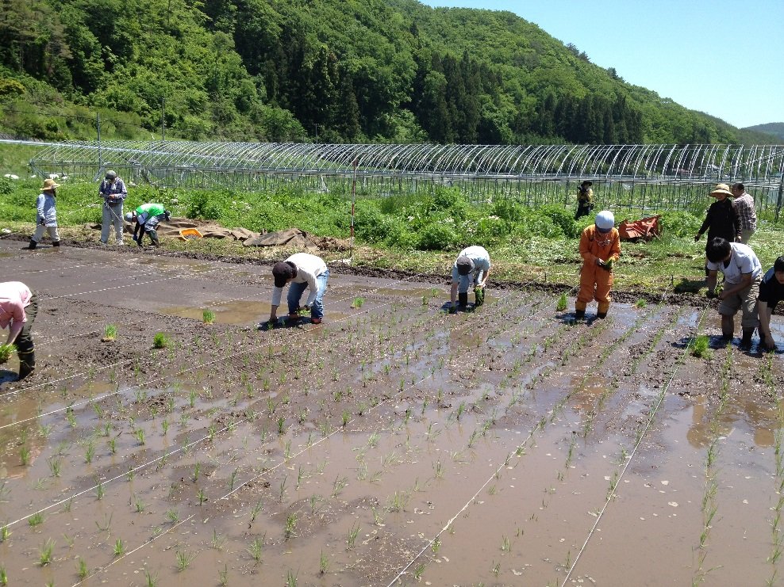
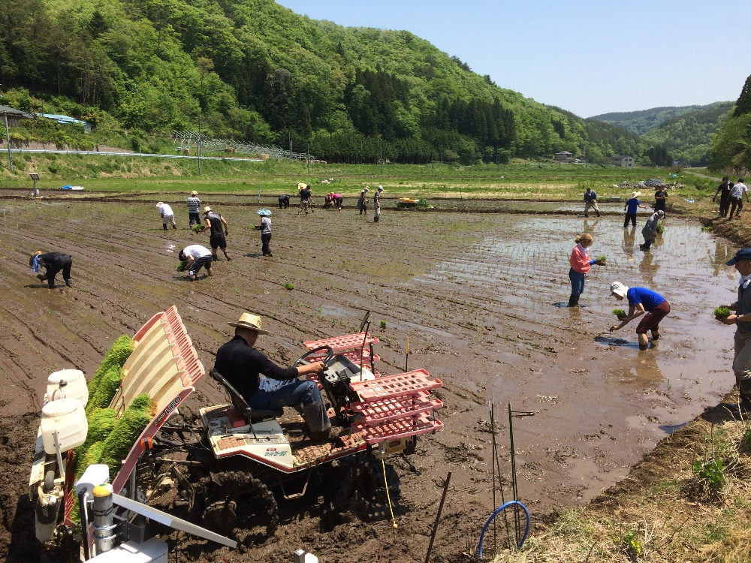
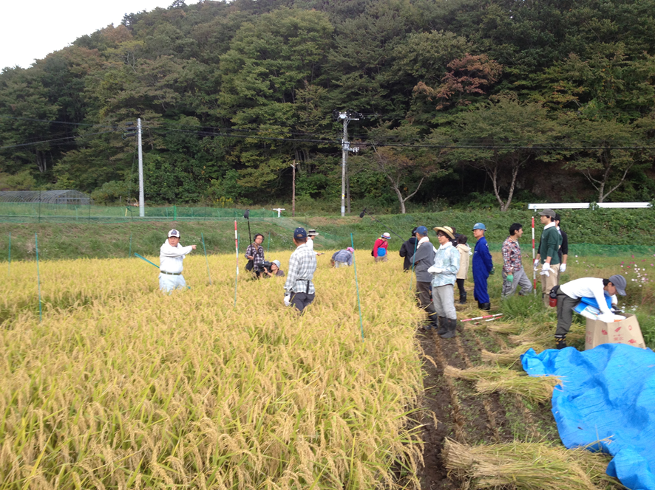
Rice cultivation test by NPO from 2012
2012.6.17
2014.6.1
2017.5.21

Slide 14
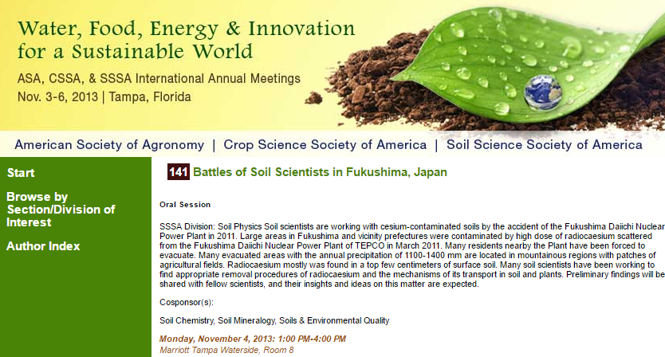
Sharing of scientific knowledge

Slide 15
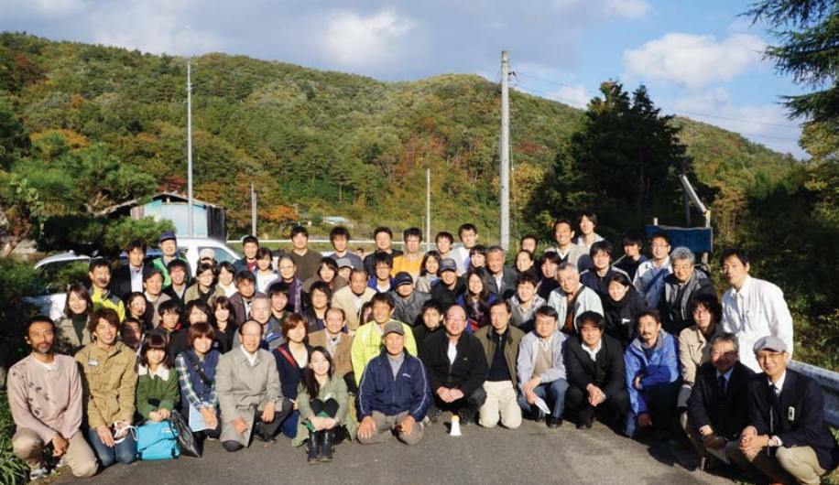
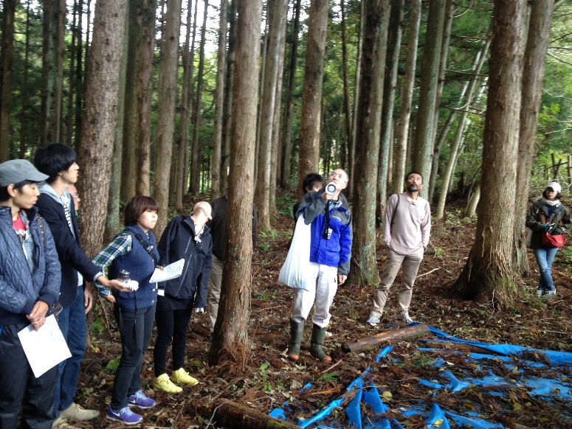
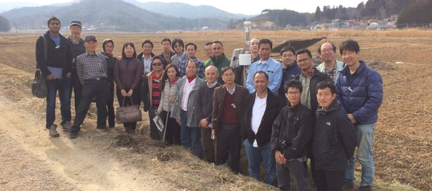
Iitate Village field tours by soil scientists
Japanese Society of Soil Physics
27 Oct. 2013
The 5th International Workshop of CAAM
6-8 March 2016

Slide 16

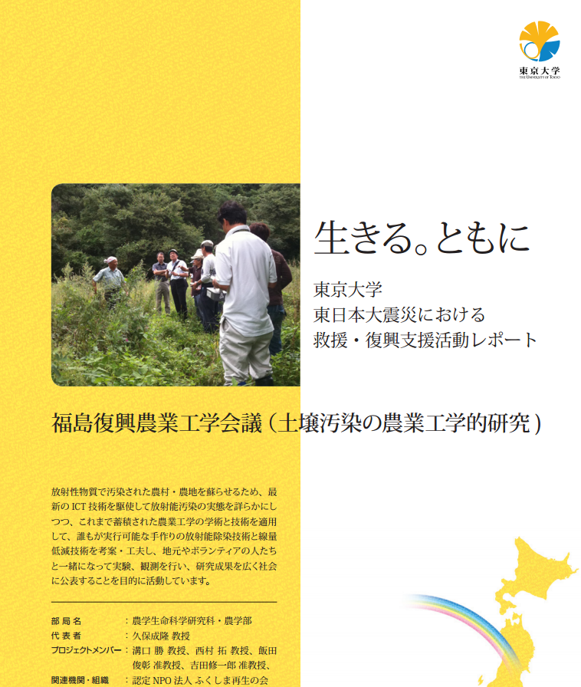
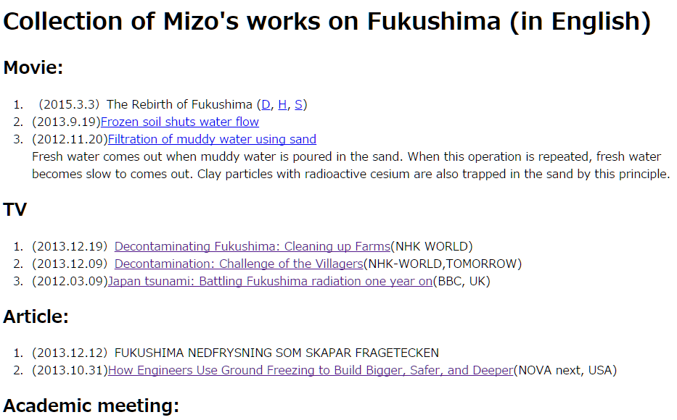
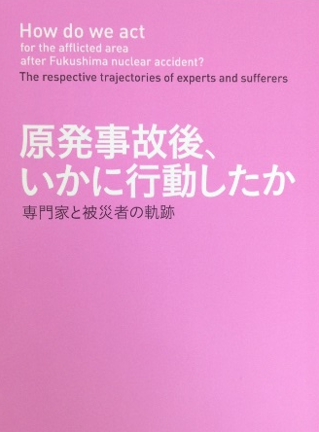
Activity reports can be downloaded from homepage
http://www.iai.ga.a.u-tokyo.ac.jp/mizo/edrp/fukushima/Fukushima_articles.html

Slide 17
Current status of our activities in Iitate Village

Slide 18
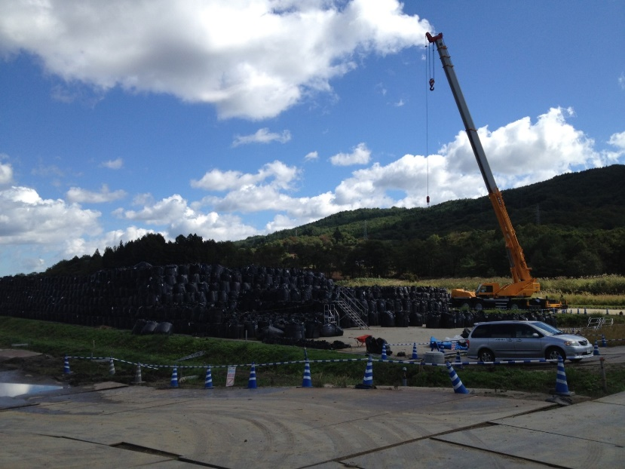
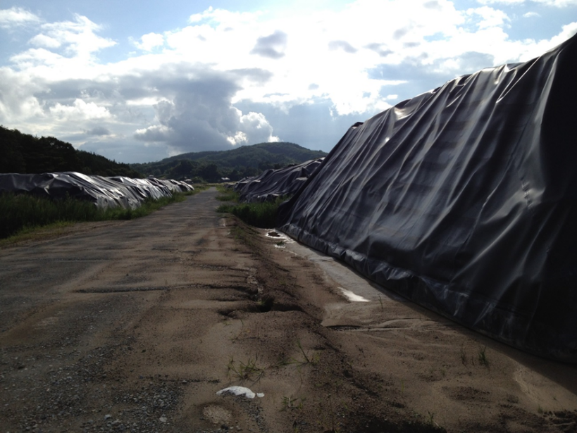
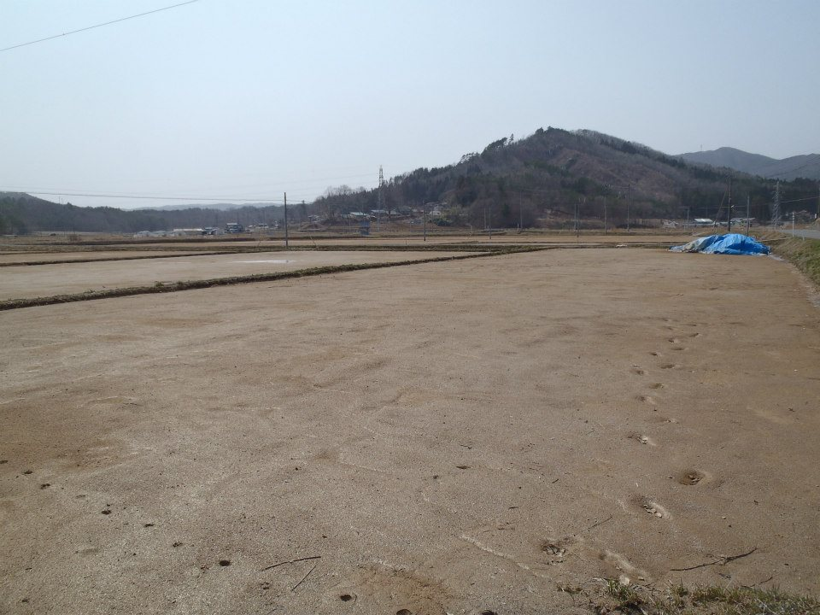
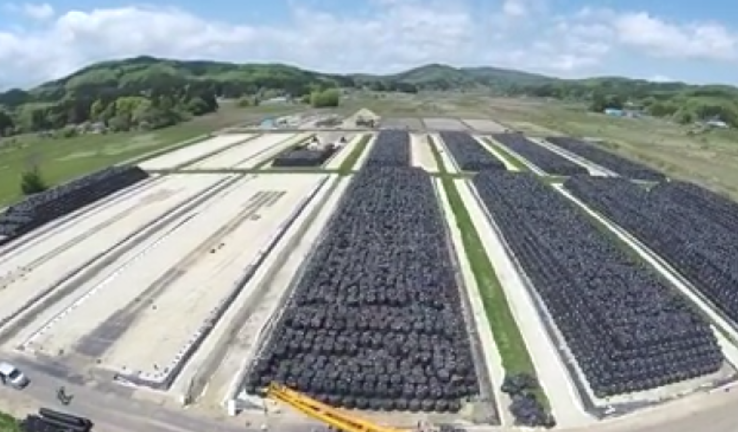
After the decontamination in Iitate
Decontamination work (2014.10)
“Temporal-temporal” storage space in a paddy
Soil dressing of farmland by sand (2015.3)
Click to movie

Slide 19
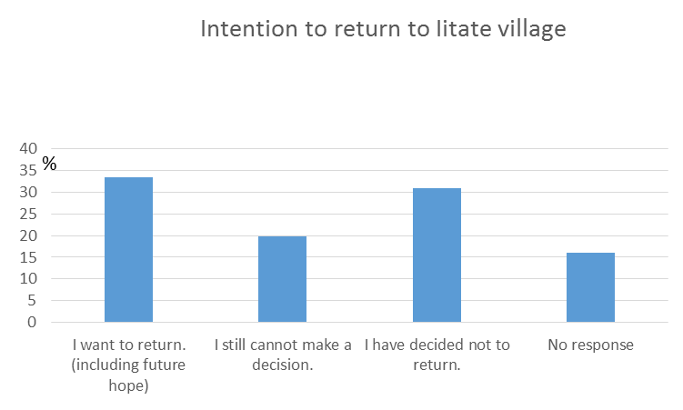

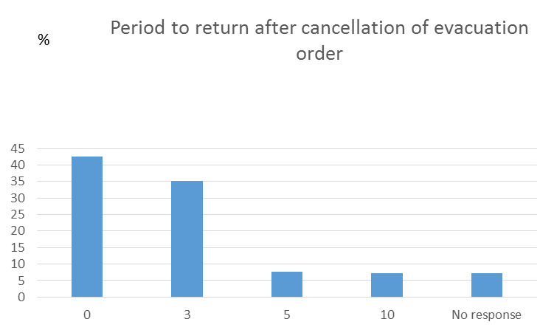
Present situation as seen from resident's intention survey
(Extract from Public Information “Iitate”, issue 1, April 2017)
426
Period to return after cancellation of evacuation order
The survey
period: Jan 4-18, 2017
target: Household representatives(2844)
method: postal distribution&collection Number of responses: 1274 (44.7%)
years

Slide 20
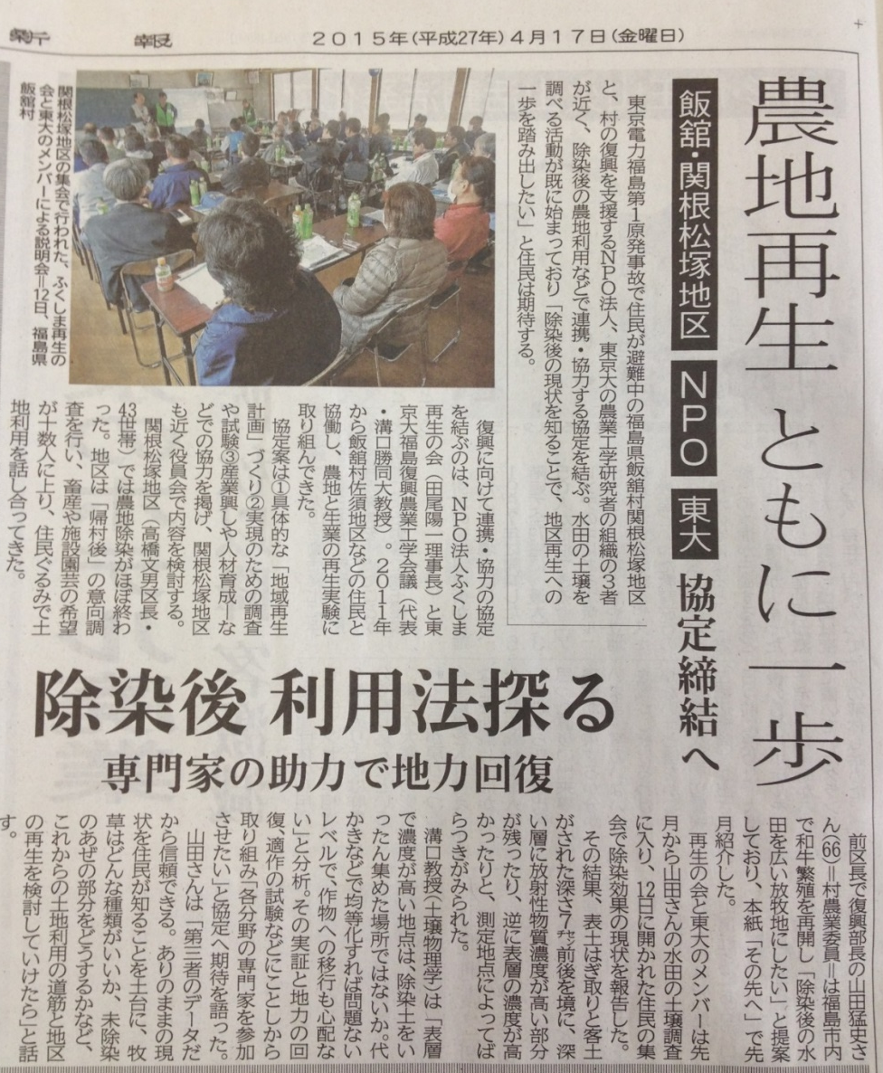
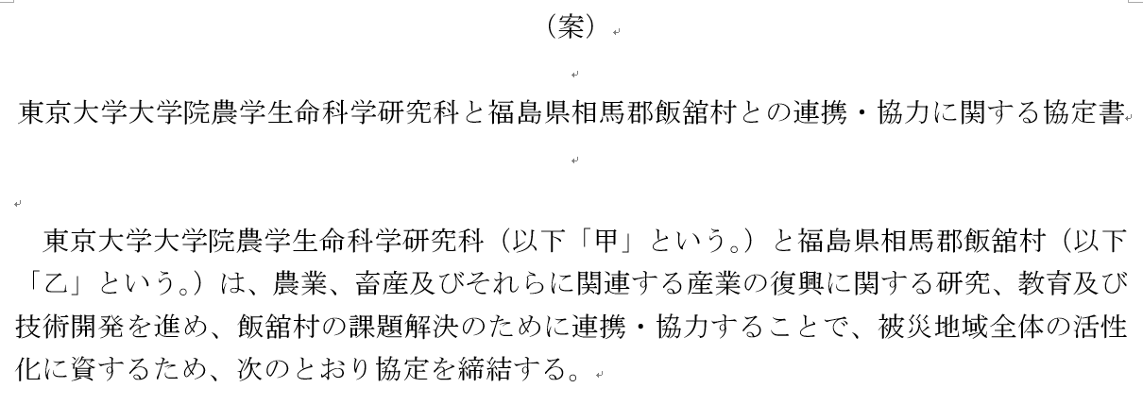
New challenges for the agriculture resurrection
Collaboration
among farmers,
NPO and UTokyo
Collaboration
between
Iitate Village and UTokyo

Slide 21
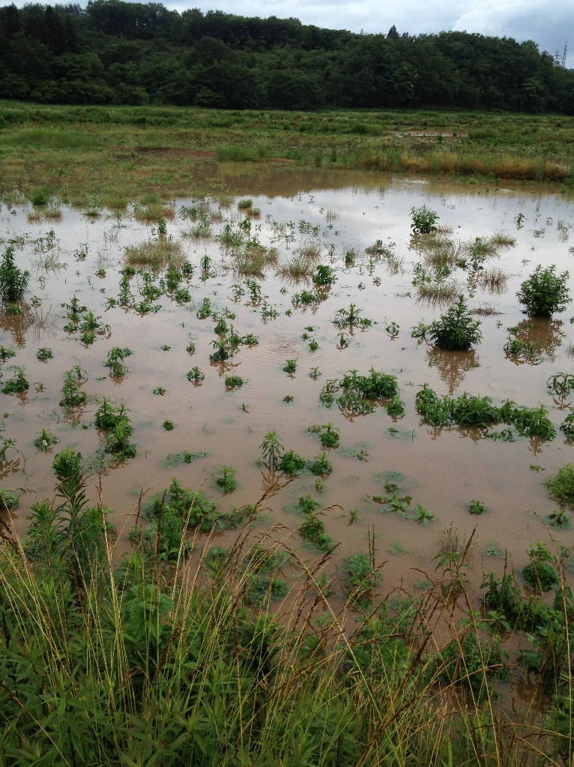
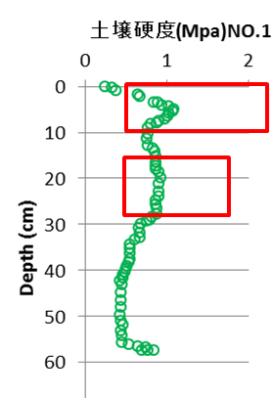
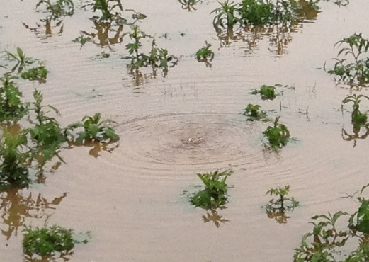
Improvement of Drainage defective farmland
Soil hardness (MPa)
depth (cm)
Fig.1 Drainage defective farmland immediately after decontamination.
A hard pan was formed at a depth of 5 cm by stepping on a heavy machine for decontamination in addition to conventional paddy field hard pan at a depth of 20 cm.
Heavy rain:
https://www.youtube.com/watch?v=AlTwmayfVtw
Mysterious bubbling:
https://www.youtube.com/watch?v=1YlaKdTu8kg

Slide 22
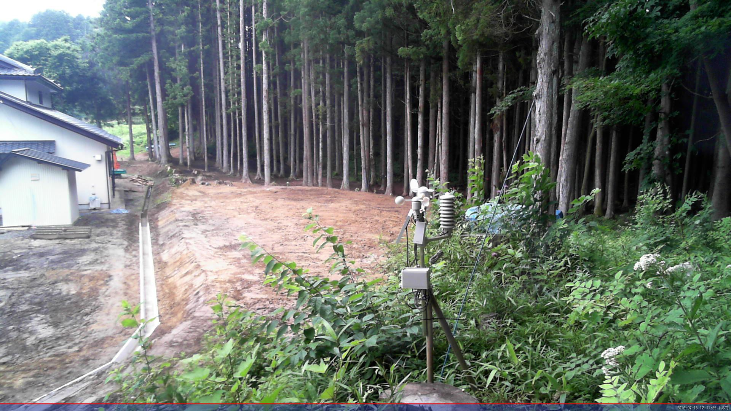
Forest decontamination
Windproof forest behind a house in Hiso, Iitate Village

Slide 23
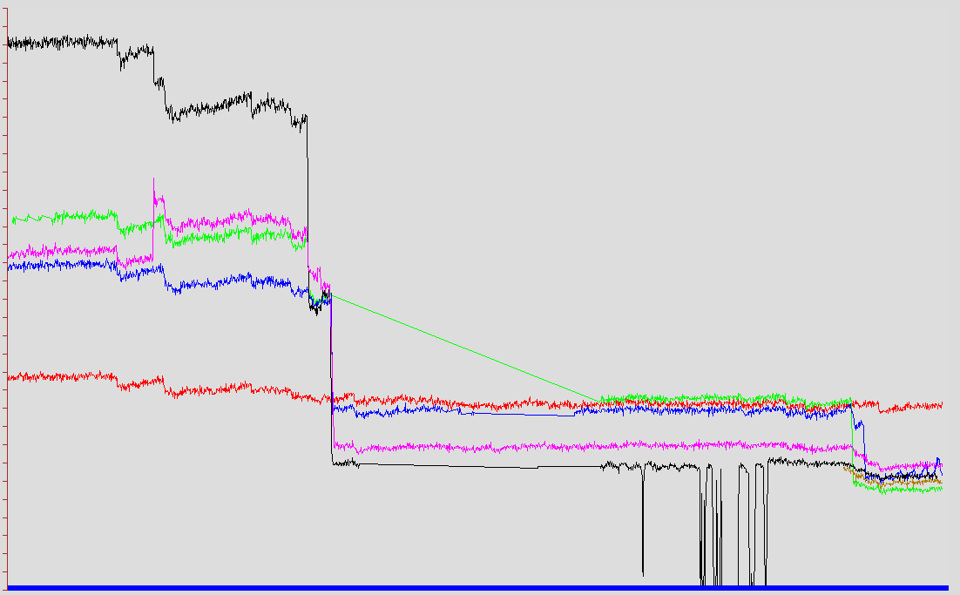
A
http://ns2.misao.co.jp/hiso/
3
μSv/h
Primary decontamination on June 24-26
Using a compact power shovel
Peel off leaves and mulch leaves by 10 cm
Embed in a hole on clay layer 1 m deep
C
2
D
B
Secondary decont. on Aug. 6-7
Decontamination effect
3.0 → 0.6 uSv/h
K
1
Decontamination of hot spot on June 23
Removal of dead branch from the ground surface
0
6/12
6/24
2016
8/6
Fig.2 Changes in air dose rate in the process of embedding forest floor
Click to poster

Slide 24
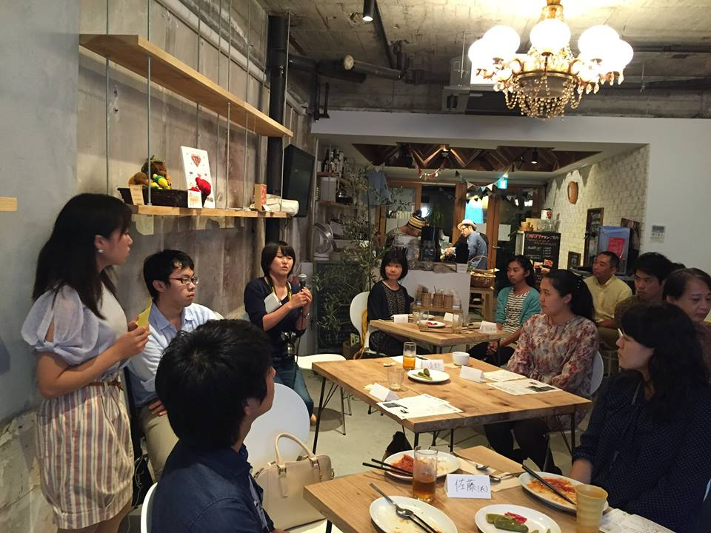
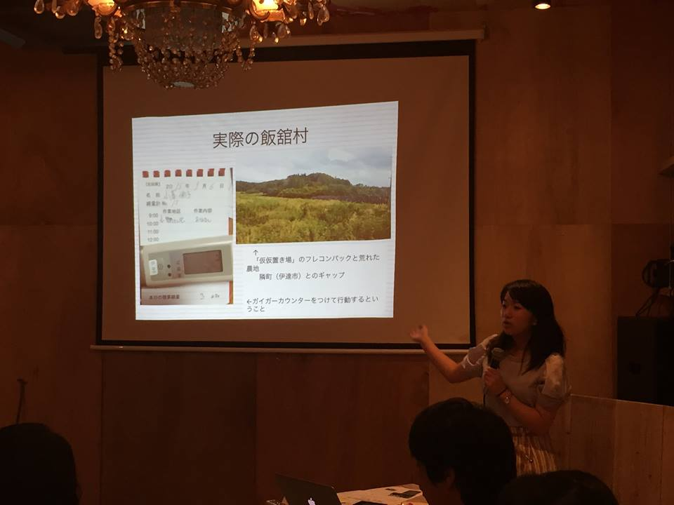
Eradication of “harmful rumors” by connecting producers and consumers
A student at Felis Women's University reported on what she studied at the Iitate Village Study Tour.
Everyone exchanged opinions while eating cuisine made with Iitate village at a restaurant in Yokohama.

Slide 25
Conclusion
Forest management
  RCs circulation in forest
  Forest fire risk
After decontamination
  Resumption of agricultural production
  Regeneration of local community
Eradication of harmful rumors, etc.
A lot of complex problems remain
  Relating to both nature and the humano-sphere on a scale close to human life (JpGU)

Slide 26

Thank you for your attention
Memorial seal for this session participant (special souvenir)

